Slide 1
Create Kubernetes cluster with Kubeadm and Calico
Including a master node and a two worker nodes.
R.G.

Slide 2
Create virtual machines
- It is needed to create two virtual machines (one for each node)
- Ubuntu 20.04 TLS
- Need to create two virtual machines with the normal process
After creating VM, they must be started. Then, you use the Ubuntu 20.04 TLS ISO file to put the OS.
Install Ubuntu with minimum requirements, nothing else needed. Give the VM names like master, worker, or easy identifiable names, as they will be much used in future.
Role | IP | OS | RAM | CPU
Master | 172.16.0.4* | Ubuntu 20.04 TLS | 2Gb | 2
Worker | 172.16.0.5* | Ubuntu 20.04 TLS | 1Gb | 1
Worker 2 | 172.16.0.6* | Ubuntu 20.04 TLS | 1Gb | 1
* The Ips are assigned automatically by the DHCP after we create a virtual box network (in next slide)

Slide 3
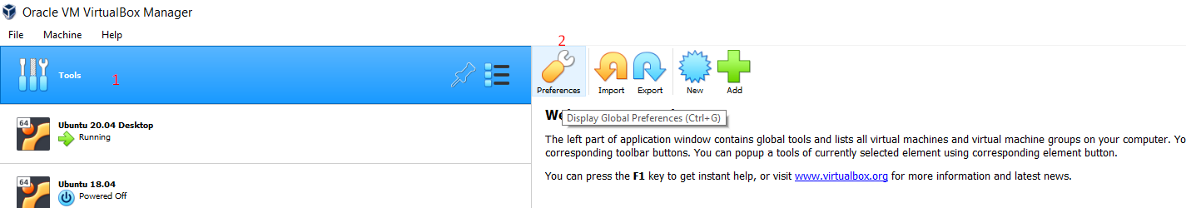
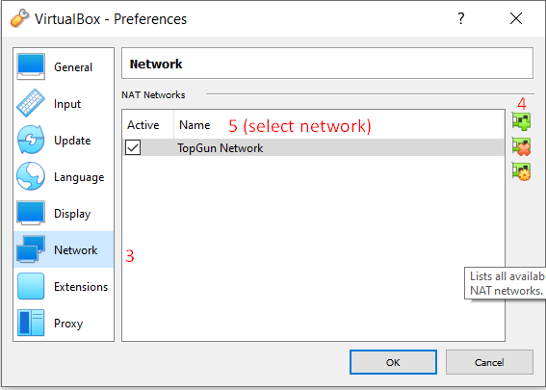
Create network for virtual machines
In virtual Box, a network must be created for the VMs to talk among them

Slide 4
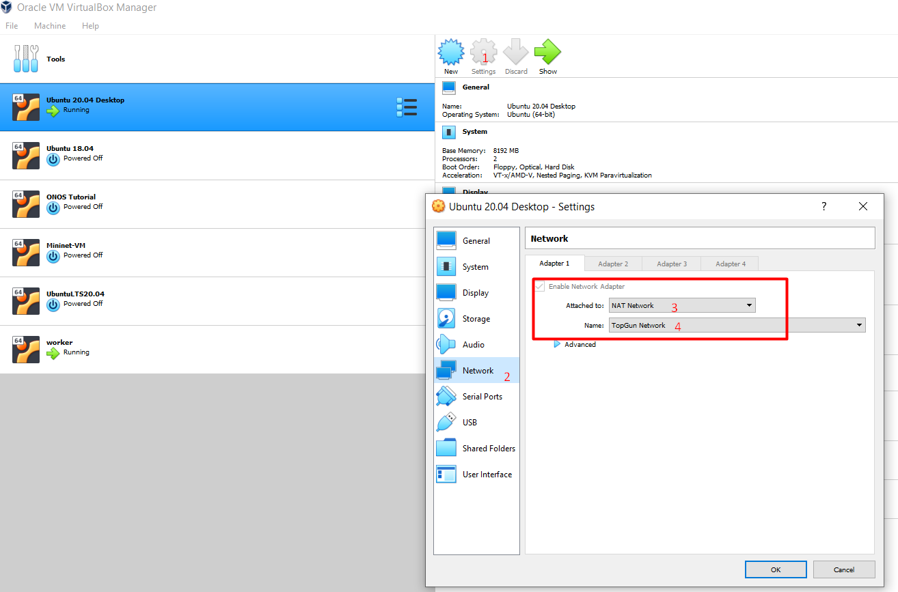
Create network for virtual machines (2)
Need to access the settings of each VM (two in our case, which will be master node and worker node), and select in the network settings NAT network (in our case, TopGun)

Slide 5
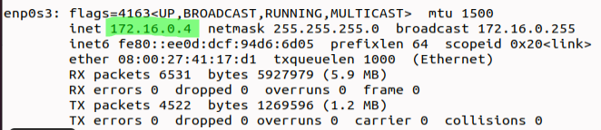
Steps for both VM to work before installing Kubernetes
Execute commands:
sudo apt install net-tools -> Install ifconfig commands and etc
sudo apt-get install openssh-server -> Install to allow to do ssh connections among VMs if needed (probably needed in future for testing purposes).
Check IP of VM
Execute command ifconfig -> As a result, it gives several interfaces. The one with name epn0s3 is the IP of the VM.

Slide 6
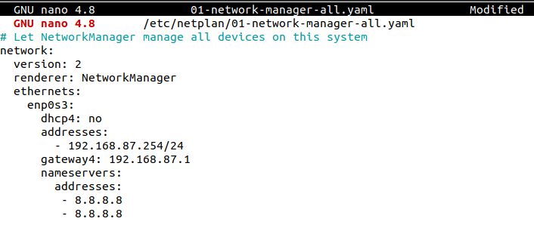
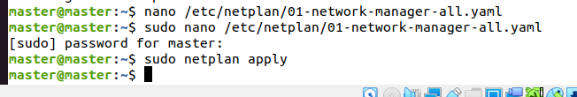
Assign static IP to Virtual Machine (if needed)

Slide 7
Test Ips, SSH
- Try a SSH connection from one VM (master) to the other (worker), as a last step to check that the network is working fine
Execute command ssh user@ip*
*Ej. ssh mastervm@172.16.0.4
In this moment, everything is ready to create Kubernetes cluster with Kubeadm.

Slide 8
Steps for both VM (Master and worker)
Log in as root user (every command from now on needs to be executed as root): sudo su – (or putting sudo before every command, whichever you prefer)
Disable Firewall: ufw disable
Disable swap: swapoff -a; sed -i '/swap/d' /etc/fstab
Update sysctl settings for Kubernetes networking: cat >>/etc/sysctl.d/kubernetes.conf<<EOF
net.bridge.bridge-nf-call-ip6tables = 1
net.bridge.bridge-nf-call-iptables = 1
EOF
sysctl --system
https://www.youtube.com/watch?v=mMmxMoprxiY
https://github.com/justmeandopensource/kubernetes/blob/master/docs/install-cluster-ubuntu-20.md

Slide 9
Install Docker Engine
apt install -y apt-transport-https ca-certificates curl gnupg-agent software-properties-common
curl -fsSL https://download.docker.com/linux/ubuntu/gpg | apt-key add -
add-apt-repository "deb [arch=amd64] https://download.docker.com/linux/ubuntu $(lsb_release -cs) stable"
apt update
apt install -y docker-ce=5:19.03.10~3-0~ubuntu-focal containerd.io
apt install -y docker-ce (for latest version)

Slide 10
Install Kubernetes
curl -s https://packages.cloud.google.com/apt/doc/apt-key.gpg | apt-key add -
echo "deb https://apt.kubernetes.io/ kubernetes-xenial main" > /etc/apt/sources.list.d/kubernetes.list
apt update && apt install -y kubeadm=1.18.5-00 kubelet=1.18.5-00 kubectl=1.18.5-00
UPDATED WITH LAST PAKCETS: apt update && apt install -y kubeadm kubelet kubectl:
apt update && apt install -y kubeadm=1.22.1-00 kubelet=1.22.1-00 kubectl=1.22.1-00
* Already installs kubectl, kubeadm and kubelet
https://www.youtube.com/watch?v=mMmxMoprxiY
https://github.com/justmeandopensource/kubernetes/blob/master/docs/install-cluster-ubuntu-20.md

Slide 11


Steps for only Master node (1) Always with root permission, with command sudo su -) or putting sudo in front of every command
Initialize Kubernetes : sudo kubeadm init --pod-network-cidr=192.168.0.0/16
Ejecutar los comandos que vienen a continuacion:
mkdir -p $HOME/.kube
sudo cp -i /etc/kubernetes/admin.conf $HOME/.kube/config
sudo chown $(id -u):$(id -g) $HOME/.kube/config
Dowload Calico,yaml file from website https://docs.projectcalico.org/manifests/calico.yaml
Edit the Calico.yaml file. Since the BGP has a method that the pods connect to the first IP that is available and working, it can lead to errors when you have many interfaces in a machine. To solve this, we need to edit the Calico.yaml file and change the following values corresponding to section auto-detect the BGP IP address. Instead, the type (or name) should be “IP_AUTODETECTION_METHOD” and the value selected is “can-reach=172.16.0.4” which is the IP of my master node. That means, BGP will choose only an IP for the node that can connect to my master node.
Value by default: BAD
Personalized value: GOOD
https://www.youtube.com/watch?v=mMmxMoprxiY
https://github.com/justmeandopensource/kubernetes/blob/master/docs/install-cluster-ubuntu-20.md
https://docs.projectcalico.org/reference/node/configuration#ip-autodetection-methods

Slide 12
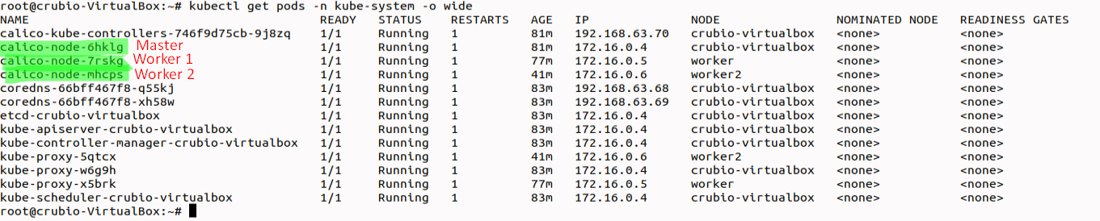
Steps for only Master node (2) Always with root permission, with command sudo su -) or putting sudo in front of every command
Once Calico.yaml file is edited, execute command: kubectl apply –f calico.yaml (file is supposed to be in same directory where command is executed)
After a couple minutes, execute command: watch kubectl get pods -n kube-system (if OK, after creating worker, everypod is running with status 1/1)
Create Cluster join command (to create worker nodes for the master node): kubeadm token create --print-join-command
It will generate something like this (it is the command needed to be executed in worker node to join to a master):
This picture is from the end, but it is only to show how columns “READY” and “STATUS ” should look like
https://www.youtube.com/watch?v=mMmxMoprxiY
https://github.com/justmeandopensource/kubernetes/blob/master/docs/install-cluster-ubuntu-20.md

Slide 13
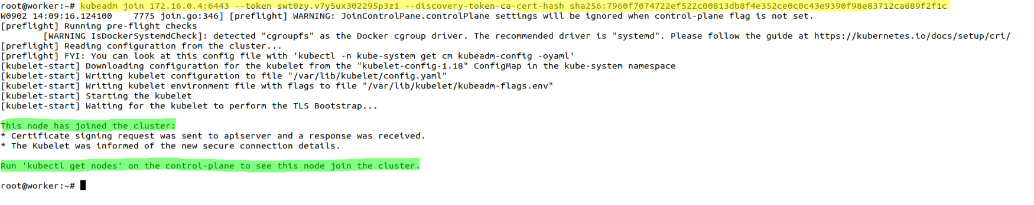
Steps for each worker node
Copy that command in yellow (result of previous slide) and execute in each node (Virtual Machine) that you want to join the cluster.
Expected result is a success message saying that “Execute kubectl get nodes in your control-plane node (master node)” to view nodes in the cluster.
https://www.youtube.com/watch?v=mMmxMoprxiY
https://github.com/justmeandopensource/kubernetes/blob/master/docs/install-cluster-ubuntu-20.md

Slide 14
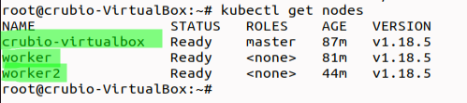
Checking that cluster is up
Only from the master node, executing the command kubectl get nodes, the output should be:
If everything is good, after joining two nodes to the cluster, the command kubectl get pods –n kube-system –o wide should look like this:

